Slide 1
Recap
Encoder
Add & Norm Feed Forward
N_{X}
Add & Norm
Multi-Head Attention
Positional
+
Embedding
Input Embedding
Inputs

Slide 2


Attention Mechanism and Transformers
Video 8 : Flow of information in Transformers

Slide 3
Transformers
Encoder
was mWiaecgsehhtt desudgirerade
Encoder
Decoder
Encoder
Decoder
Encoder
Decoder
Encoder
Decoder
Encoder
Decoder
Encoder
Decoder
whatHaorwe ayroe uyoduoing
Decoder

Slide 4
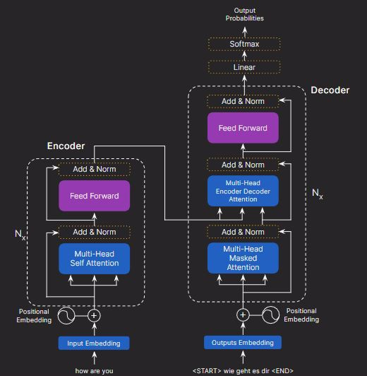
The Flow of Information
Multi-Head Masked Attention

Slide 5
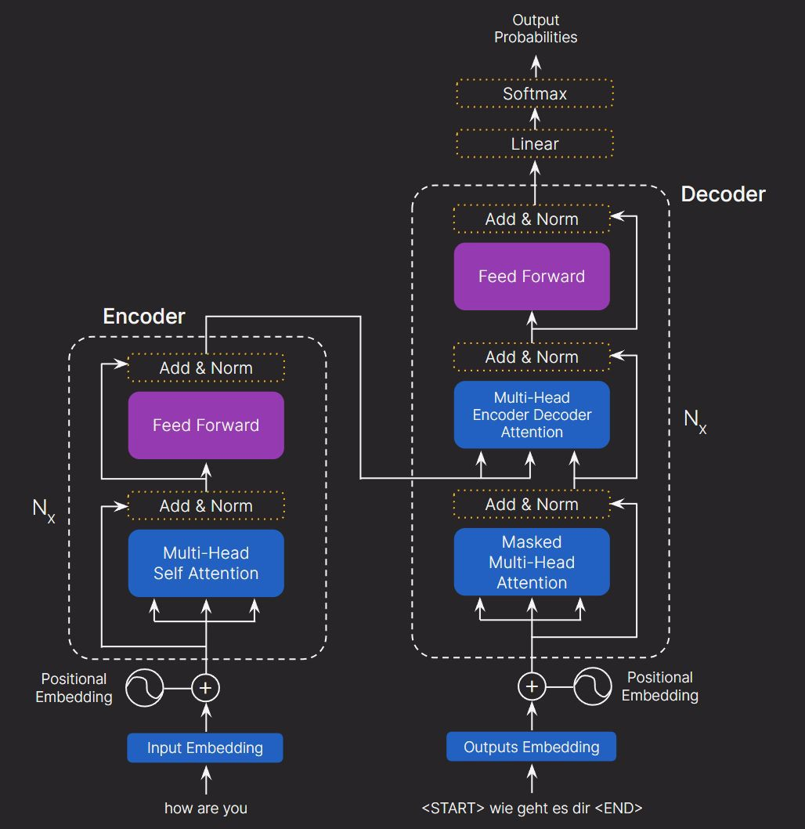
The Flow of Information
Word embeddings of tokens goes as input in encoder.
Multi-Head Masked Attention
how are you

Slide 6
The Flow of Information
The transformers use positional embedding to capture sequential information of the tokens.
Multi-Head Masked Attention
Positional
Embedding

Slide 7
The Flow of Information
The model uses positional encoding with word embeddings to generate a unique vector for each token.
P = Positional Embedding + Word embedding
Multi-Head Masked Attention
Positional
+
Embedding

Slide 8
The Flow of Information
Multi-Head Masked Attention

Slide 9
The Flow of Information
Multi-Head Masked Attention

Slide 10
The Flow of Information
Multi-Head Masked Attention

Slide 11
The Flow of Information
Multi-Head Masked Attention

Slide 12
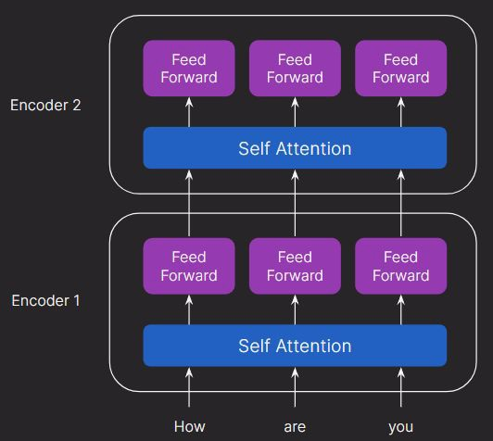
Multi-Head Self Attention
Decoder 6
Encoder 6
Decoder 2
Feed Forward
Feed Forward
Feed Forward
Encoder-Decoder Attention
Decoder 1
Self Attention

Slide 13
The Flow of Information
Multi-Head Masked Attention

Slide 14
The Flow of Information
There are 2 inputs to the decoder from the encoder:
First input: Output matrix serves as the query and key matrix
Multi-Head Masked Attention
<START> wie geht es dir <END>

Slide 15
The Flow of Information
There are 2 inputs to the decoder from the encoder:
First input: Output matrix “R” which serves as the query and key matrix
Second input: Predicted text
Multi-Head Masked Attention
<START> wie geht es dir <END>

Slide 16
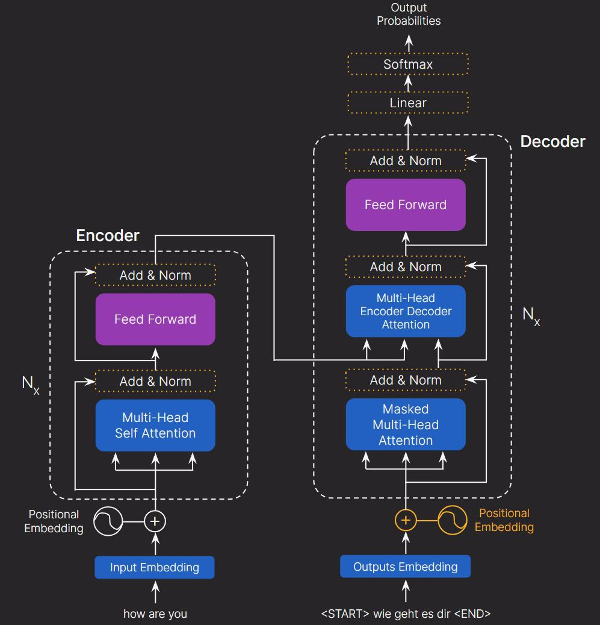
The Flow of Information
Inputs are embedded just like the encoder part.
Multi-Head Masked Attention

Slide 17
The Flow of Information
Masked multi-headed attention is performed.
This method focuses on relevant sentence parts without previewing future words.
Multi-Head Masked Attention

Slide 18
The Flow of Information
The resultant matrix is added to the original matrix of the decoder part and then normalized.
Multi-Head Masked Attention

Slide 19
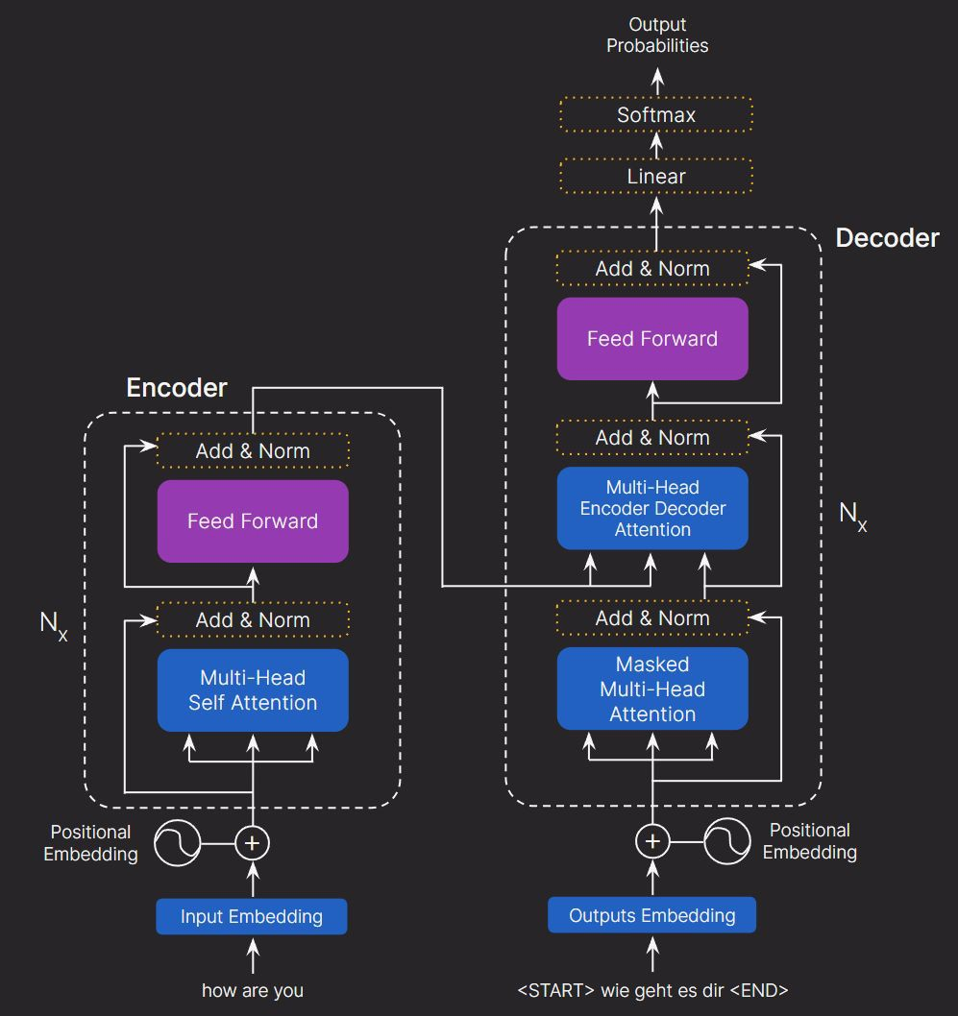
The Flow of Information
3 inputs to the multi-head encoder decoder attention:
Value vector from the encoder
Key vector from the encoder
Query vector after the first add and normalize step
Multi-Head Masked Attention

Slide 20
The Flow of Information
The output matrix is passed through a feed forward network
It is added to the resultant matrix from earlier add and norm step to get the decoder stack output.
Multi-Head Masked Attention

Slide 21
The Flow of Information
Output of the decoder is passed through a linear layer followed by a softmax layer to get the prediction.
Multi-Head Masked Attention

Slide 22
Up Next: Implementation of Transformers in Jupyter

Slide 23
IN AIR

Slide 24


Output Probabilities
Softmax Linear
Decoder
Add & Norm
Feed Forward
Encoder
Add & Norm
Add & Norm
Multi-Head
N_{X}
Feed Forward
Encoder Decoder
Attention
N_{X}
Add & Norm
Add & Norm
Multi-Head Masked Attention
Multi-Head Self Attention
Positional
+
+
Positional Embedding
Embedding
Input Embedding
Outputs Embedding
how are you
<START> wie geht es dir <END>

